Slide 1
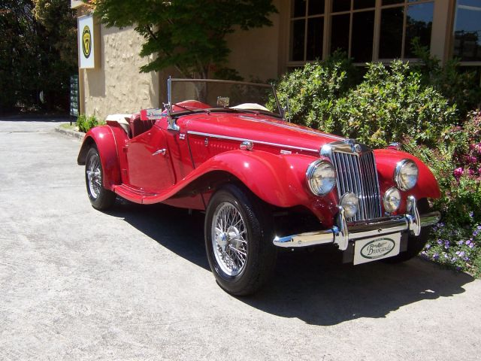
“JULIET” 1954 MG TF ROADSTER Proud Owners: Naomi & Mark Horsfield
Factory
Production Record
Model/Type: TF Roadster
Chassis No: …………. Engine No: …………. Build Date: 00/00/1954
Paint Colour:
Vehicle History
MG TF……….. was built on ….. March 1954 at Abingdon, England and was originally imported into Australia by ……….
Technical Specifications
Engine: 4 Cylinder petrol
Displacement: 1250 cc Brake horsepower: 57 Fuel consumption: 26 mpg
Gearbox: 4 speed
Top speed: 78mph
Body weight: 900kg
Wheel size: 15 in

